Slide 1
Forecasting Financial Trends Using BNS Dataset
Presented by Group 7
Yong Hui Lin
Bharath Modhwadiya
Honey Jain
Saloni Bhandari
Manoj Suchendra Reddy
Notes:
Welcome to our presentation where we would be trying to forecast the stock price of BNS, the Bank of Nova Scotia, a prominent bank in Canada. We are a group number 7.

Slide 2
About the dataset
Data were taken from Kaggle: https://www.kaggle.com/datasets/nghihuynh/bank-stock-market?resource=download
Dataset Consist of the stock price of Canadian bank (1999: 2022)
The dataset has date, open, high, low, close , and the volume
Notes:
We would like to talk about the dataset. This data was taken from a Kaggle source that consisted of the stock price of three different Canadian banks, one of which is BNS. The dataset contains the date, opening price, highest price, lowest price, closing price as well as trading volume.

Slide 3
01
Data Description
Notes:
First, let us talk about the dataset first.

Slide 4
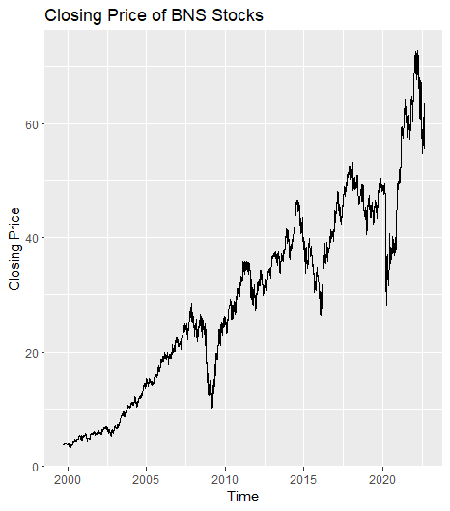
Exploratory Data Analysis
Converting the dataset into tsibble so that it could be easier to manipulate
Check to see if there are any gaps within the dataset
If there are any gaps, we would data interpolate the gaps to remove potential gaps in the dataset
Stock closing price is used for further analysis to forecast the market price value of BNS stocks.
Data was split into train and test (90:10)
Notes:
We explored the dataset first to see if there are any manipulation needed prior to data modeling. We first converted the dataset into tsibble so that we can manipulate the data for time series analysis. We then check to see if there are gaps in the dataset, which there is because the stock market is not always open. We use data interpolation to fill in the missing gaps in the dataset to prevent future errors when performing analysis. Finally, we needed to split the data into training and testing (90:10). We also saw that the dataset does not appear to be normal so a box-cox transformation would be needed.

Slide 5
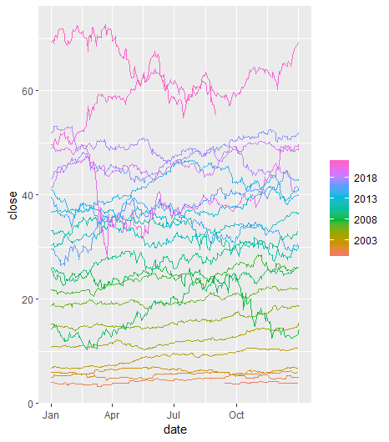
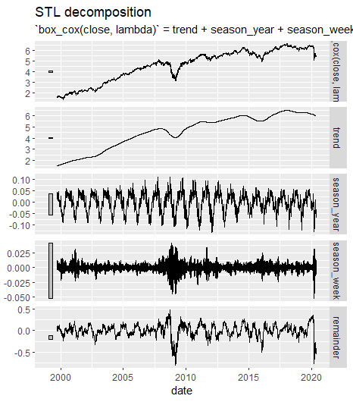
Box-cox Transformation & STL Decomposition
There are three dips within the dataset (at 2008, 2016, and 2020)
There appears to be a positive trend in the dataset
There is insufficient evidence to prove that there is seasonality within the dataset
Notes:
We first determined that the best lambda to use for the box-cox transformation is 0.24. After the transformation, we also did an STL decomposition and saw that the data is normalized and that there appears to be a positive trend within the dataset. There are also dips in the dataset in 2008, 2016, and 2020 that could be due to recessions. Finally, there does not appear to be any seasonality within the dataset.

Slide 6
02
Time Series Methodology
Notes:
After we transformed and explored the dataset, we can move on to the next step which is to determine which models to use for the final comparison.

Slide 7
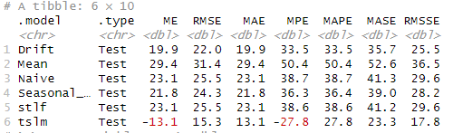
Determining a Baseline Model
We created baseline models using simpler models such as mean, naïve, seasonal naïve, drift, and tslm to forecast the stock price
TSLM yields the lowest RMSE out of the other models
TSLM would be a potential candidate for the final comparison
Notes:
We first wanted to determine a good baseline model that could be used to represent basic models in general. We created models using the mean, naïve, seasonal naïve, drift, and tslm. After looking at the accuracy of these models, we saw that the tslm yielded the lowest RMSE value, so we chosen this model as one of the potential candidates in the final comparison.

Slide 8
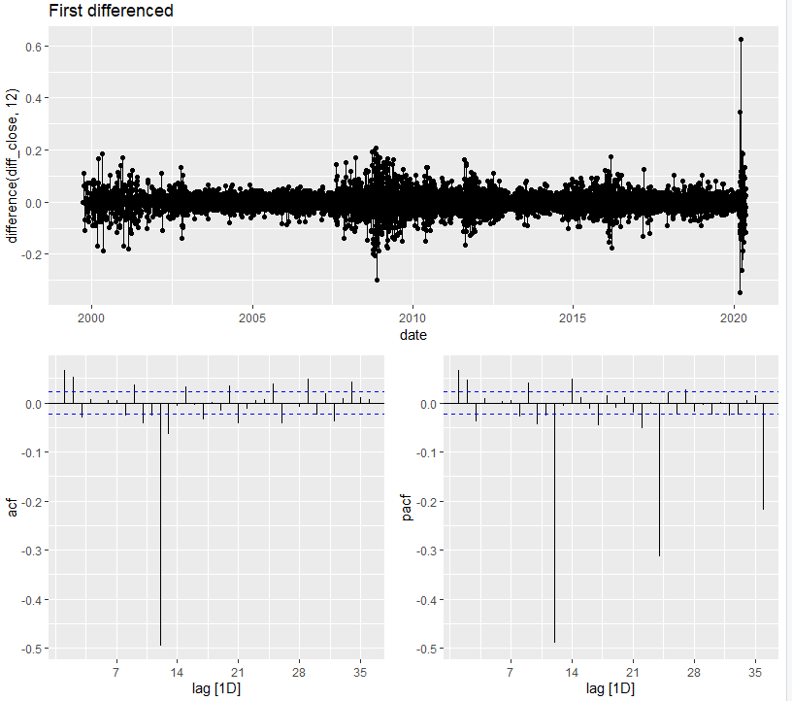
ARIMA models
We saw that the first difference is necessary so that the data would become stationary
From the ACF and PACF plot of the First Differenced: 1. there is an exponential decay in the PACF plot
2. there is a spike at lag 3 in the ACF plot
We conclude that an additional ARIMA to test is ARIMA(0,1,3).
We will also be using the defaulted ARIMA model: ARIMA(2,1,3)(0,0,1)[7] w/ drift
Notes:
Before determining ARIMA models, we wanted to check to see if the dataset is stationary or not. As previously mentioned, there appears to be a trend within the dataset. So using the kpss values, we determine that only the first difference is necessary to make the data stationary and that a seasonal difference is not needed. Once we took the first difference, we plot the data so that we can generate the ACF and the PACF plots. From the plots, we concluded that:
There is an exponential decay in the PACF plot
There is a spike at lag 3 in the ACF plot
-> So that meant that a potential ARIMA model that we could test in the final comparison is ARIMA(0,1,3).
In addition, we also used the defaulted ARIMA model that was determined by RStudio which is ARIMA(2,1,3)(0,0,1)[7] w/ drift.

Slide 9
Model Evaluation
Notes:
After we got the baseline model, the two ARIMA models, and the ETS model that would also be generated by Rstudio, we are now ready to evaluate the models to determine the best model to use for forecast.

Slide 10
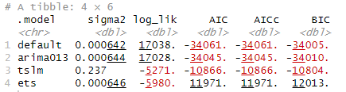
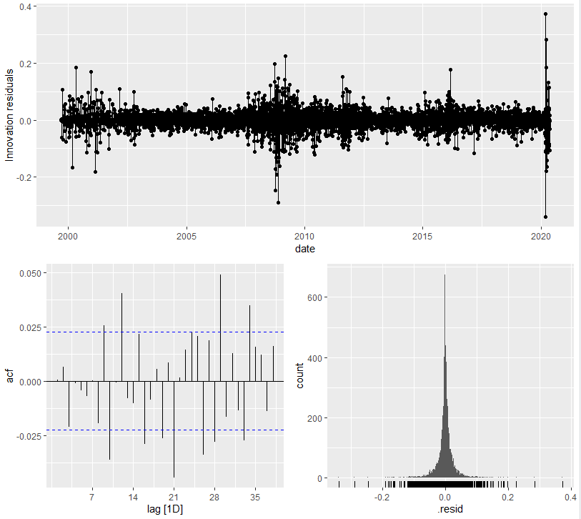
Evaluating the Models
Out of the four model candidates chosen, the best model appears to be the defaulted ARIMA model (ARIMA(2,1,3)(0,0,1)[7] w/ drift)
It has the lowest AICc value out of all the other candidates
From the residual plots, the residual does appear to resemble white noise.
Notes:
The four model candidates are:
1. the baseline model (tslm)
2. ARIMA (0,1,3)
3. ARIMA (2,1,3)(0,0,1)[7] w/ drift
4. ETS model
We look at the accuracy of the models to determine the best model. Out of the four candidates, the model with the lowest AICc value is the defaulted ARIMA model (ARIMA(2,1,3)(0,0,1)[7] w/ drift). As a result, we believe that the ARIMA(2,1,3)(0,0,1)[7] w/ drift model would be the best model that we can use to forecast the closing stock price of BNS. We also look at the residual plots and did a ljung_box analysis to determine that the residual does appear to resemble white noise.

Slide 11
Forecasting
Notes:
Now that we determine the best model to use, we also started to forecast the testing data to see how accurate the model is at predicting the closing stock price of BNS.

Slide 12
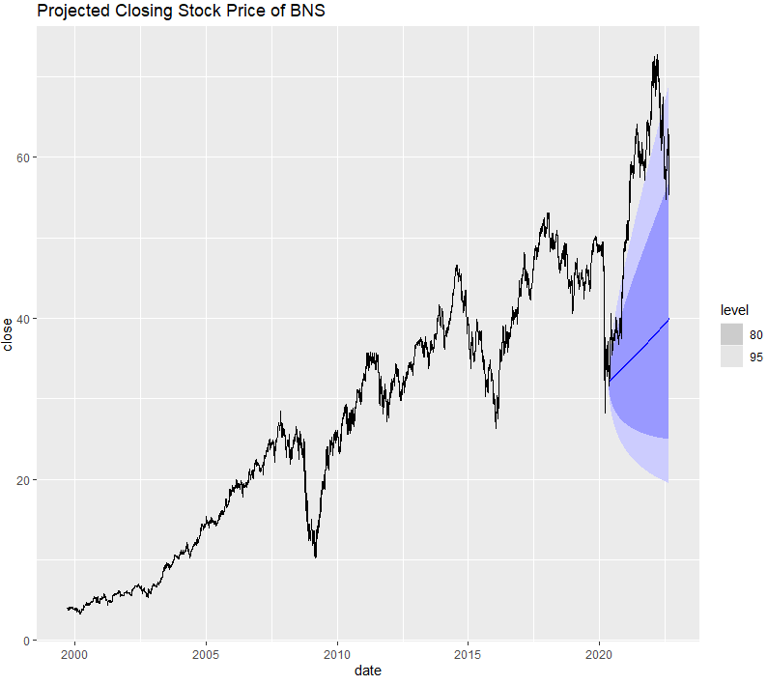

Forecasting the Closing BNS Stock Price
Here is the forecasted BNS stock price for the next 839 days (which is the testing dataset)
Blue line represents the point estimate of the stock price on each day
Dark blue region is the 80% confidence interval that the actual stock price would lie within this region
Light blue region is the 95% confidence interval that the actual stock price would lie within this region
The RMSE of the ARIMA model on the testing dataset is 21.9
Notes:
The graph on the right shows the forecasted closing stock price of BNS.
Blue line represents the point estimate of the stock price on each day
Dark blue region is the 80% confidence interval that the actual stock price would lie within this region
Light blue region is the 95% confidence interval that the actual stock price would lie within this region
The RMSE of the ARIMA model on the testing dataset came back as 21.9. After we forecasted the testing data, we noticed that the actual closing stock price of BNS is actually slightly higher than the 95% confidence interval that the ARIMA model; thus, concluding that the accuracy of the forecast might not be as accurate as what we would like.
In conclusion, it is oftentimes difficult to forecast stock prices over a long period since there are different factors that could contribute to the fluctuation of the stock price, as shown here with the BNS stock.

